Slide 1
Databases 2
SQL

Slide 2
Agenda
Group By / Having
IN / EXISTS
Subquery
Joins

Slide 3
Group By / Having
What does GROUP BY do?
What does HAVING do?
Notes:
Wie weet er nog wat GROUP BY / HAVING doet?

Slide 4
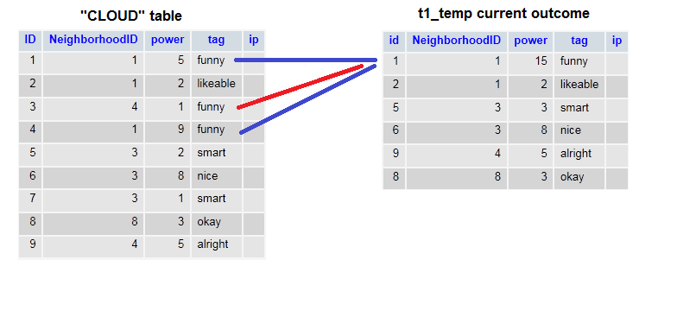
Group By

Slide 5
Group By
Notes:
Hoe is de power 15 geworden? SUM. Gebeurt niet vanzelf. How did the power become 15? SUM. Doesn't happen by itself

Slide 6
Group By
Msg 8120, Level 16, State 1, Line 3
Column 'CLOUD.power' is invalid in the select list because it is not contained in either an aggregate function or the GROUP BY clause.
Notes:
Dit gebeurt er als je niet een aggregate functie gebruikt, of in de GROUP BY zet. This happens if you don't use an aggregate function, or put it in the GROUP BY.

Slide 7
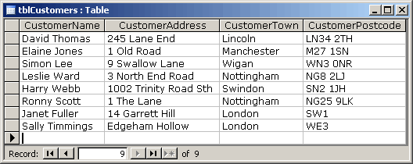
Group By / Having
SELECT * FROM tblCustomers
Notes:
Hoe haal ik het aantal personen per CustomerTown op? How do I get the number of people per CustomerTown?

Slide 8
Group By / Having
SELECT * FROM tblCustomers
GROUP BY CustomerTown

Slide 9
Group By / Having
SELECT * FROM tblCustomers
WHERE COUNT(ID) > 1
GROUP BY CustomerTown
Notes:
Toch? NEE!

Slide 10
Group By / Having
SELECT * FROM tblCustomers
WHERE COUNT(ID) > 1
GROUP BY CustomerTown
Msg 147, Level 15, State 1, Line 2
An aggregate may not appear in the WHERE clause unless it is in a subquery contained in a HAVING clause or a select list, and the column being aggregated is an outer reference.
Notes:
Toch? NEE! + Order of execution

Slide 11
Group By / Having
SELECT * FROM tblCustomers
GROUP BY CustomerTown
HAVING COUNT(ID) > 1

Slide 12
IN / EXISTS
IN will process every row from the inner query.
EXISTS will stop scanning if there is a match
Notes:
Which is faster?

Slide 13
IN
IN will process every row from the inner query
var arr = [1,2,3,4,5];
var counter = 0;
foreach(int number in arr)
{
counter++;
}

Slide 14
IN
IN will process every row from the inner query
Can use subqueries and literal values
SELECT * FROM Species s WHERE s.Age IN (
26, 27, 28
)

Slide 15
EXISTS
EXISTS will stop scanning if there is a match
var arr = [1,2,3,4,5];
bool inArray = false;
foreach(int number in arr)
{
if(number == 5)
{
inArray = true;
break; // Stop the loop
}
}

Slide 16
EXISTS
EXISTS will stop scanning if there is a match
Uses subqueries
SELECT [Name] FROM Species s WHERE EXISTS (
SELECT Age FROM Species s2
WHERE s2.Age = s.Age AND s2.ID <> s.ID
)
Notes:
Wat doet deze query? Wat zijn de blokhaken om Name? Wat is <> ? What does this query do? What are the brackets around Name? What is <> ?

Slide 17
EXISTS
EXISTS will stop scanning if there is a match
Uses subqueries
SELECT [Name] FROM Species s WHERE EXISTS (
SELECT Age FROM Species s2
WHERE s2.Age = s.Age AND s2.ID <> s.ID
)
SELECT [Name] FROM Species s WHERE s.Age IN (
SELECT Age FROM Species s2
WHERE s2.Age = s.Age AND s2.ID <> s.ID
)
Notes:
Hetzelfde maar dan IN. Gebruik de snellere variant indien mogelijk. The same but IN. Use the faster variant if possible.

Slide 18
EXISTS
EXISTS will stop scanning if there is a match
Uses subqueries
SELECT [Name] FROM Species s WHERE EXISTS (
26, 27, 28
)
SELECT [Name] FROM Species s WHERE s.Age IN (
26, 27, 28
)
Notes:
Wordt omgezet naar dit. Converts to this

Slide 19

Notes:
Venn-chart

Slide 20
SQL Joins
NATURAL JOIN
CROSS JOIN
(INNER) JOIN
LEFT (OUTER) JOIN
RIGHT (OUTER) JOIN
FULL (OUTER) JOIN

Slide 21
SQL - Joins – NATURAL Join
Joins two tables based on a column with a “shared” name between two tables
SQL Server does not support it
Don’t use it, or do use it
Remember the “shared” columns

Slide 22
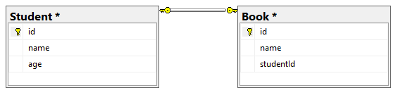
SQL - Joins – Example database
What kind of relationship is this?
What are the PK and FK of the relationship?
What kind of “information” (not data!) can we get from the database?
Notes:
1:N – PK: id – FK: studentId - How many people own more than 10 books?

Slide 23
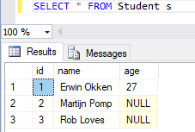
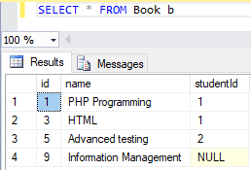
SQL - Joins – Example database
Notes:
1:N – PK: id – FK: studentId - How many people own more than 10 books?

Slide 24
SQL - Joins – CROSS Join
SELECT * FROM Student CROSS JOIN Book
SELECT * FROM Student, Book
How many rows does this query return?
Notes:
Returns count_table_1 * count_table_2;

Slide 25
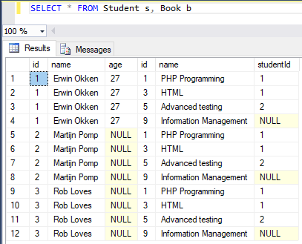
SQL - Joins – CROSS Join
SELECT * FROM Student s, Book b
Notes:
4 * 3 = 12

Slide 26
SQL - Joins – FULL Join
Joins two tables, regardless of the fact if there is a reference
Examples: Also returns student without book;
books without student

Slide 27
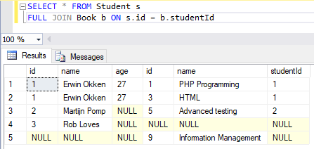
SQL - Joins – FULL Join

Slide 28
SQL - Joins – LEFT Join
Joins two tables, regardless of the fact if there is a reference from the left (first) table to the right (joined) table
Examples: Also returns students without book

Slide 29
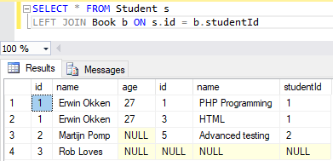
SQL - Joins – LEFT Join

Slide 30
SQL - Joins – RIGHT Join
Joins two tables, regardless of the fact if there is a reference from the right (joined) table to the left (first) table
Examples: Also returns books without student

Slide 31
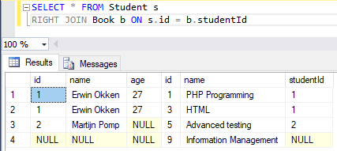
SQL - Joins – RIGHT Join

Slide 32
SQL - Joins – INNER Join
Joins two tables, only returns the rows where there is a reference from the left (first) table to the right (joined) table and vice versa
Examples: Only returns students that have books

Slide 33
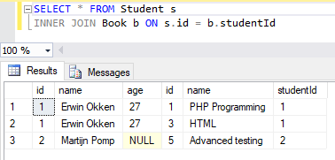
SQL - Joins – INNER Join

